Slide 1
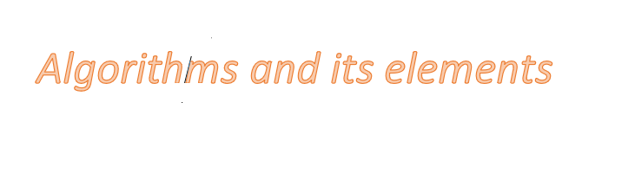

Slide 2
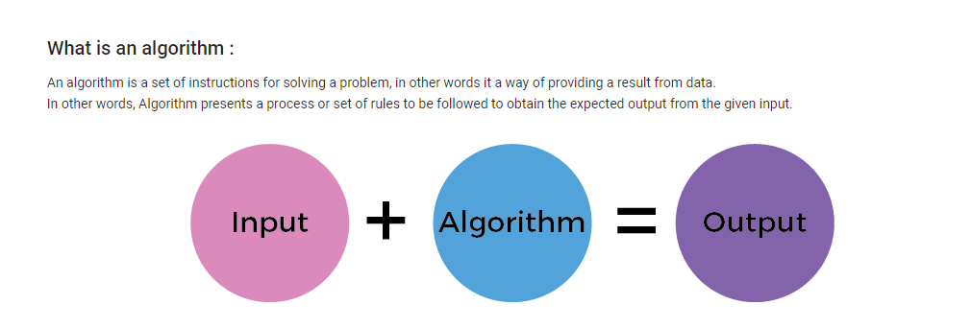

Slide 3
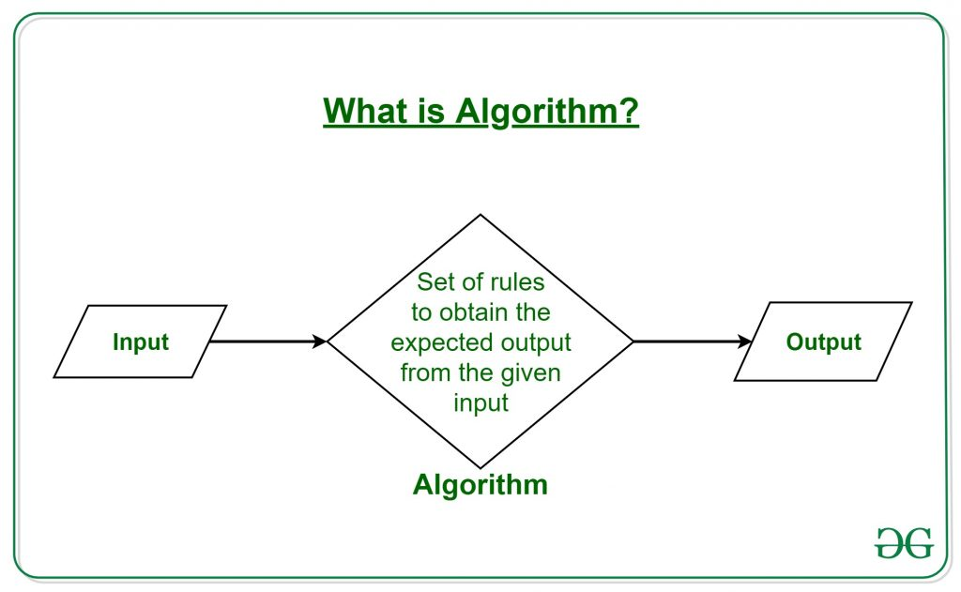

Slide 4
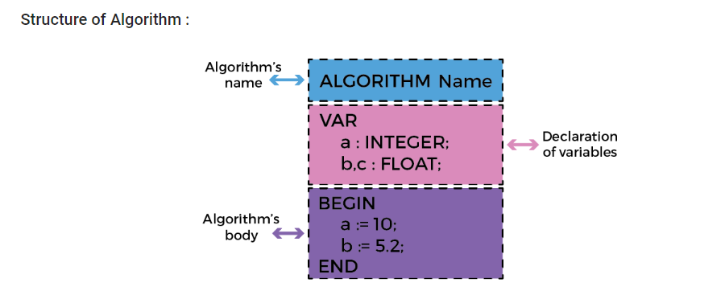
Why do we write algorithms : Develop the logic of programming. Stay focused on the logic only. Check the complexity of the program.

Slide 5
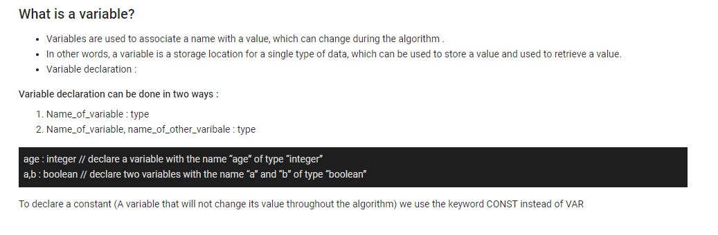

Slide 6
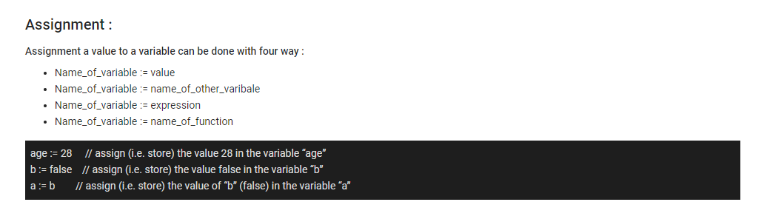

Slide 7
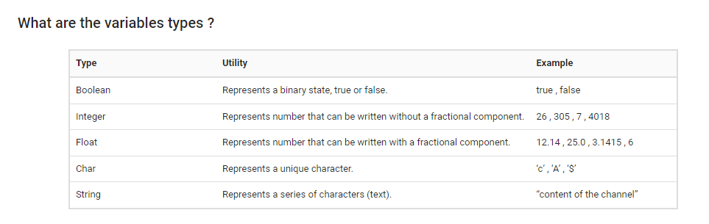

Slide 8
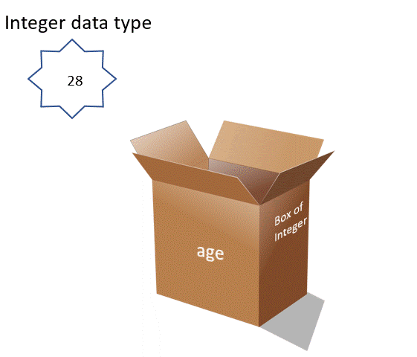
Compatibility of types When you assign a value to a variable, the two types must be compatible with each other. For example, you cannot assign an string value to an integer variable.

Slide 9
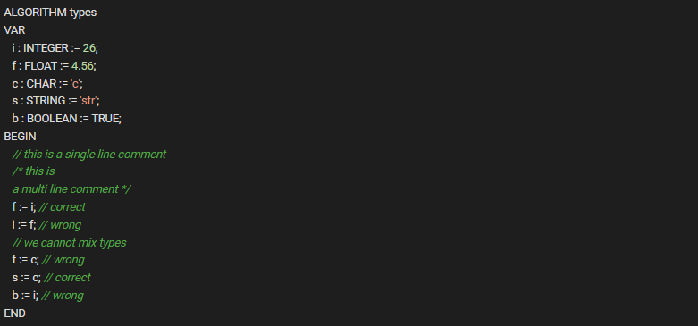

Slide 10


